Slide 1

CSE 299 Junior Design Course
Rahman Farhat Lamisa
1731068042
Group: 01

Slide 2
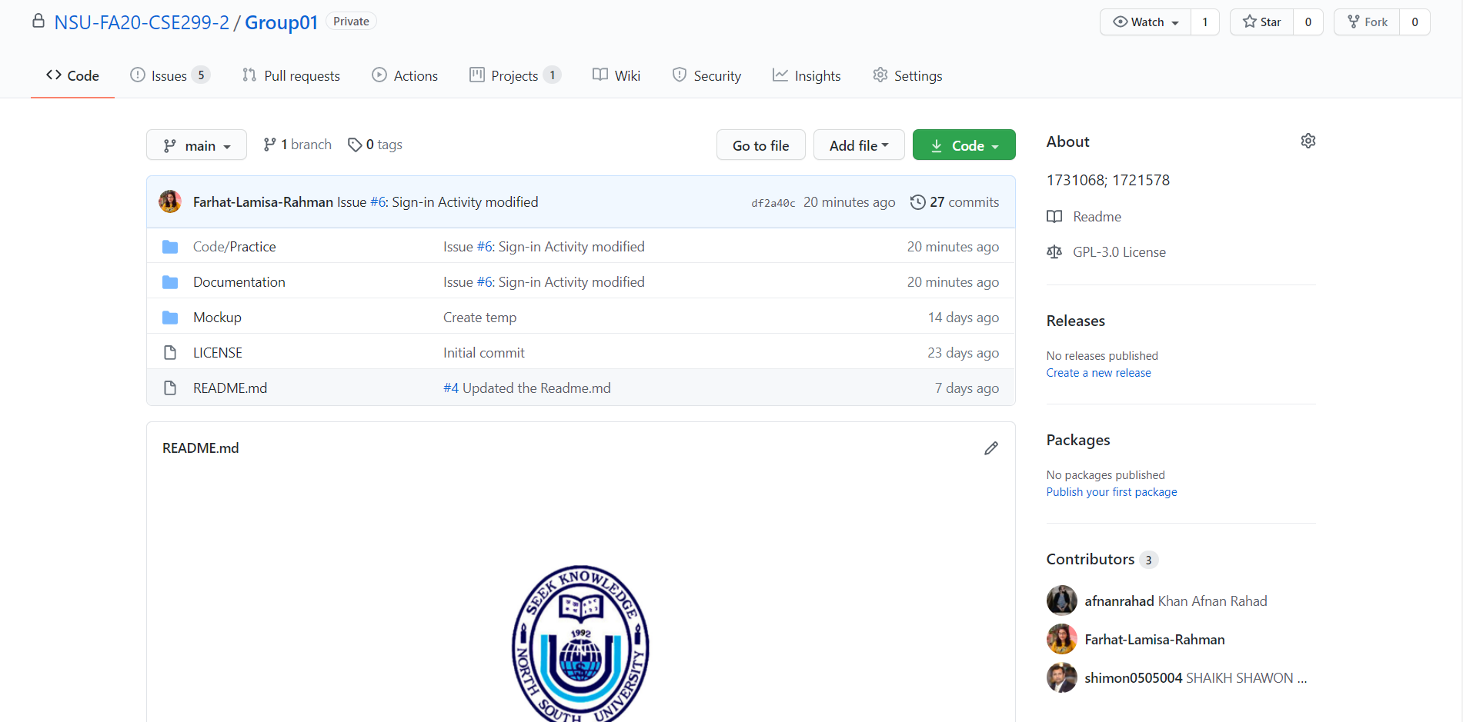
GitHub Front Page

Slide 3
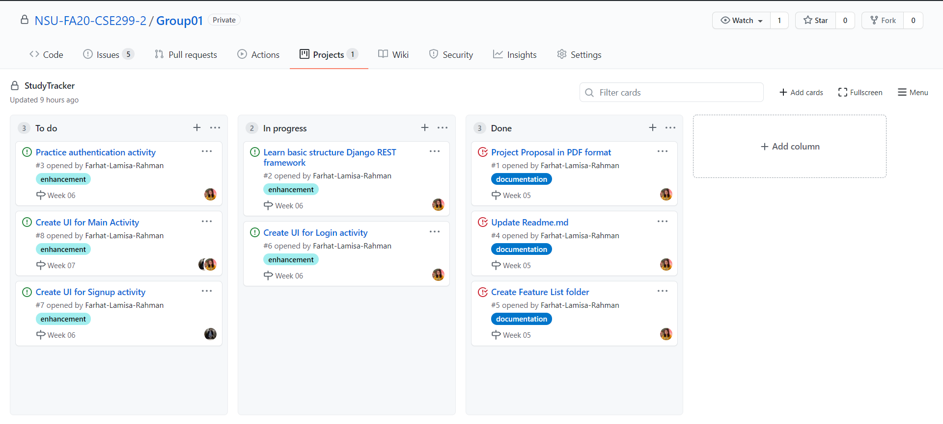
GitHub Board

Slide 4
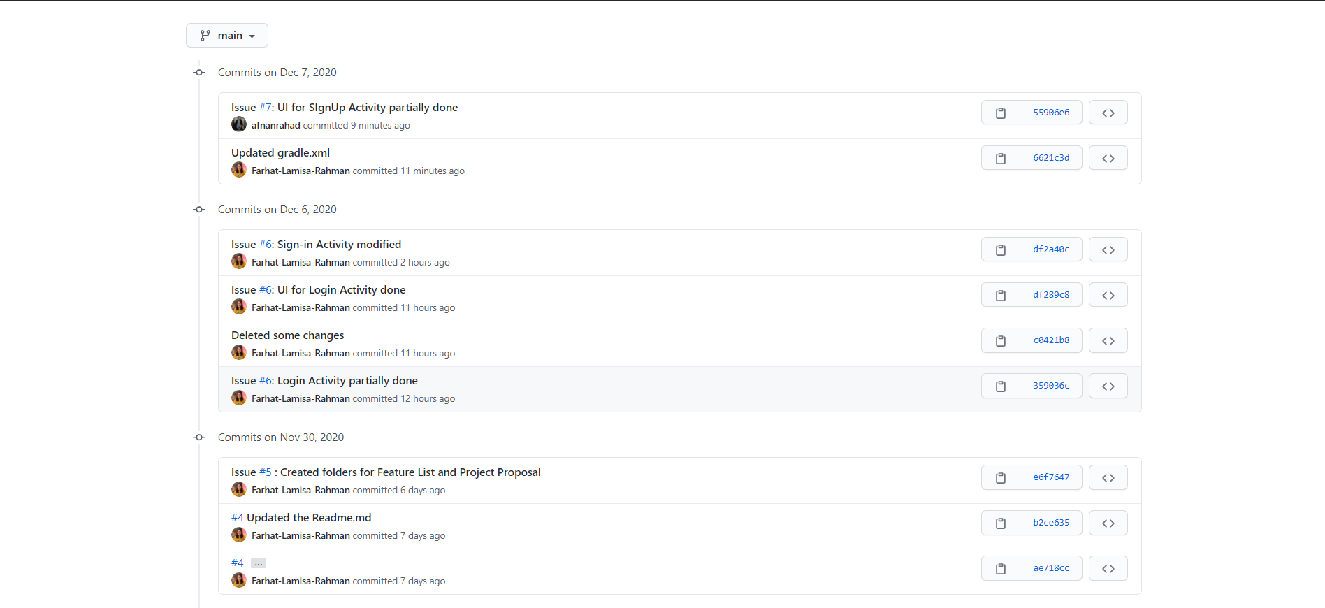
Week 6's commits

Slide 5
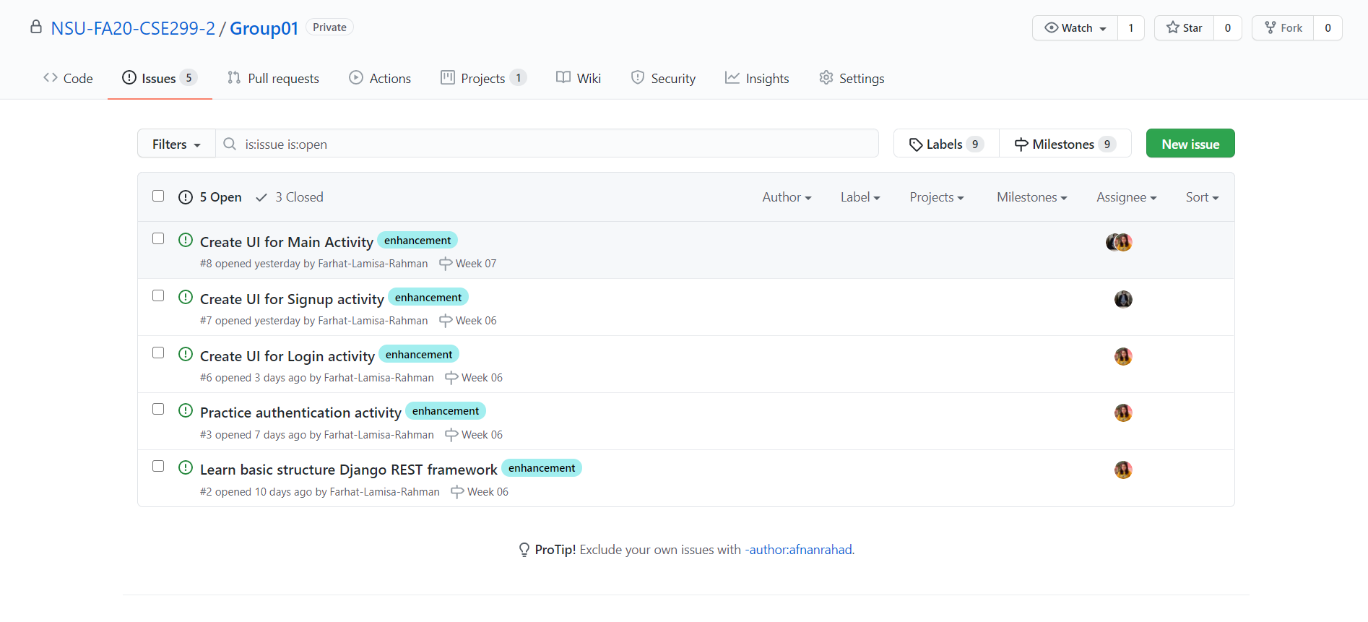
Issues

Slide 6
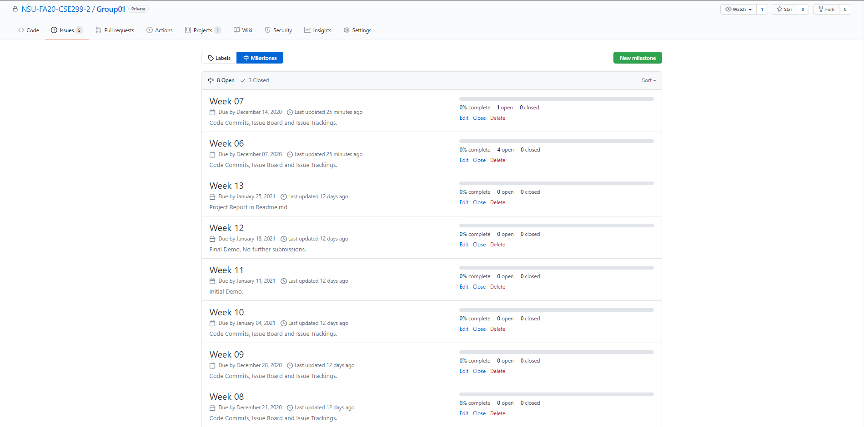
Milestones

Slide 7
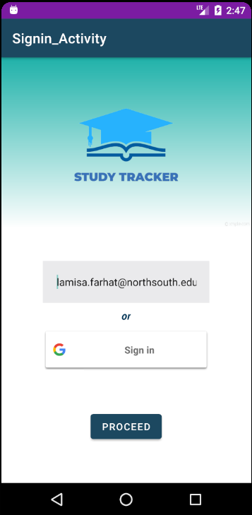
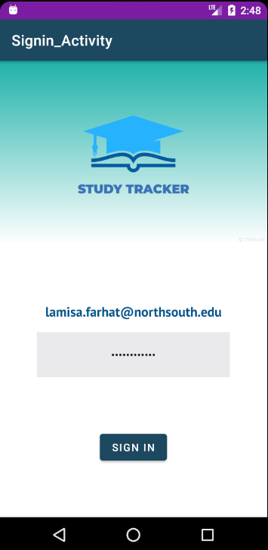
UI for Sign-in Activity

Slide 8
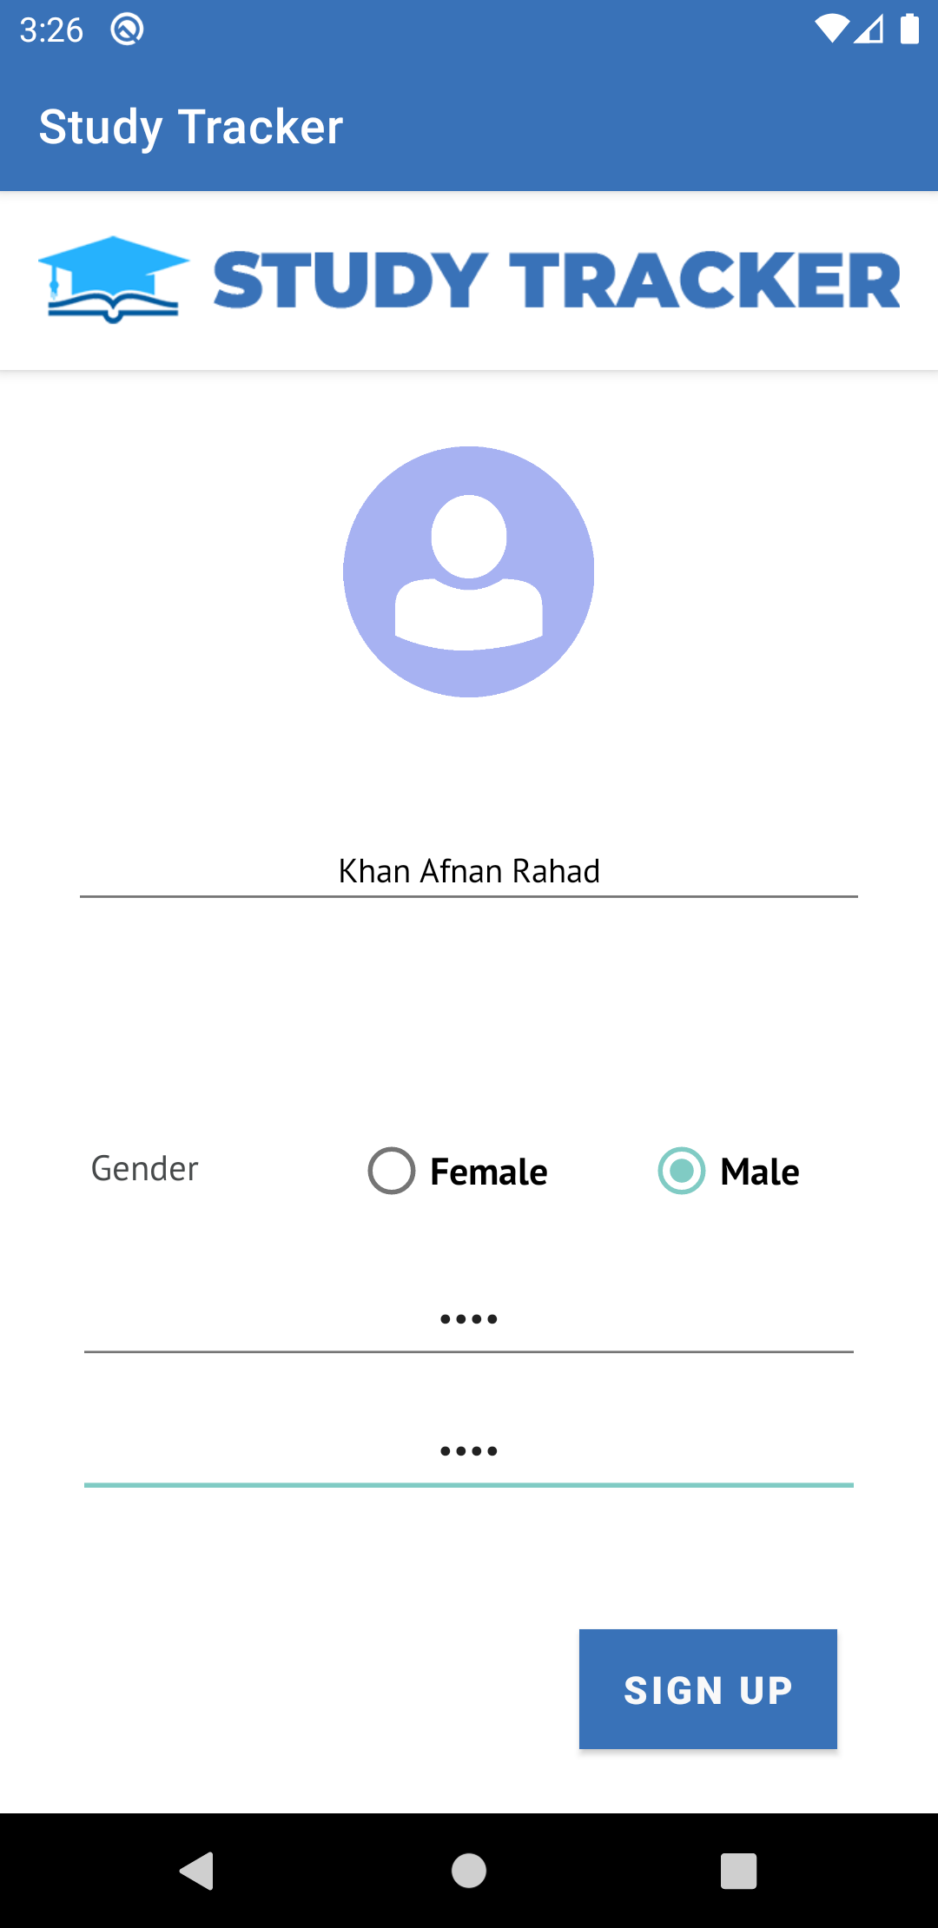
UI for Sign-up Activity

Slide 9
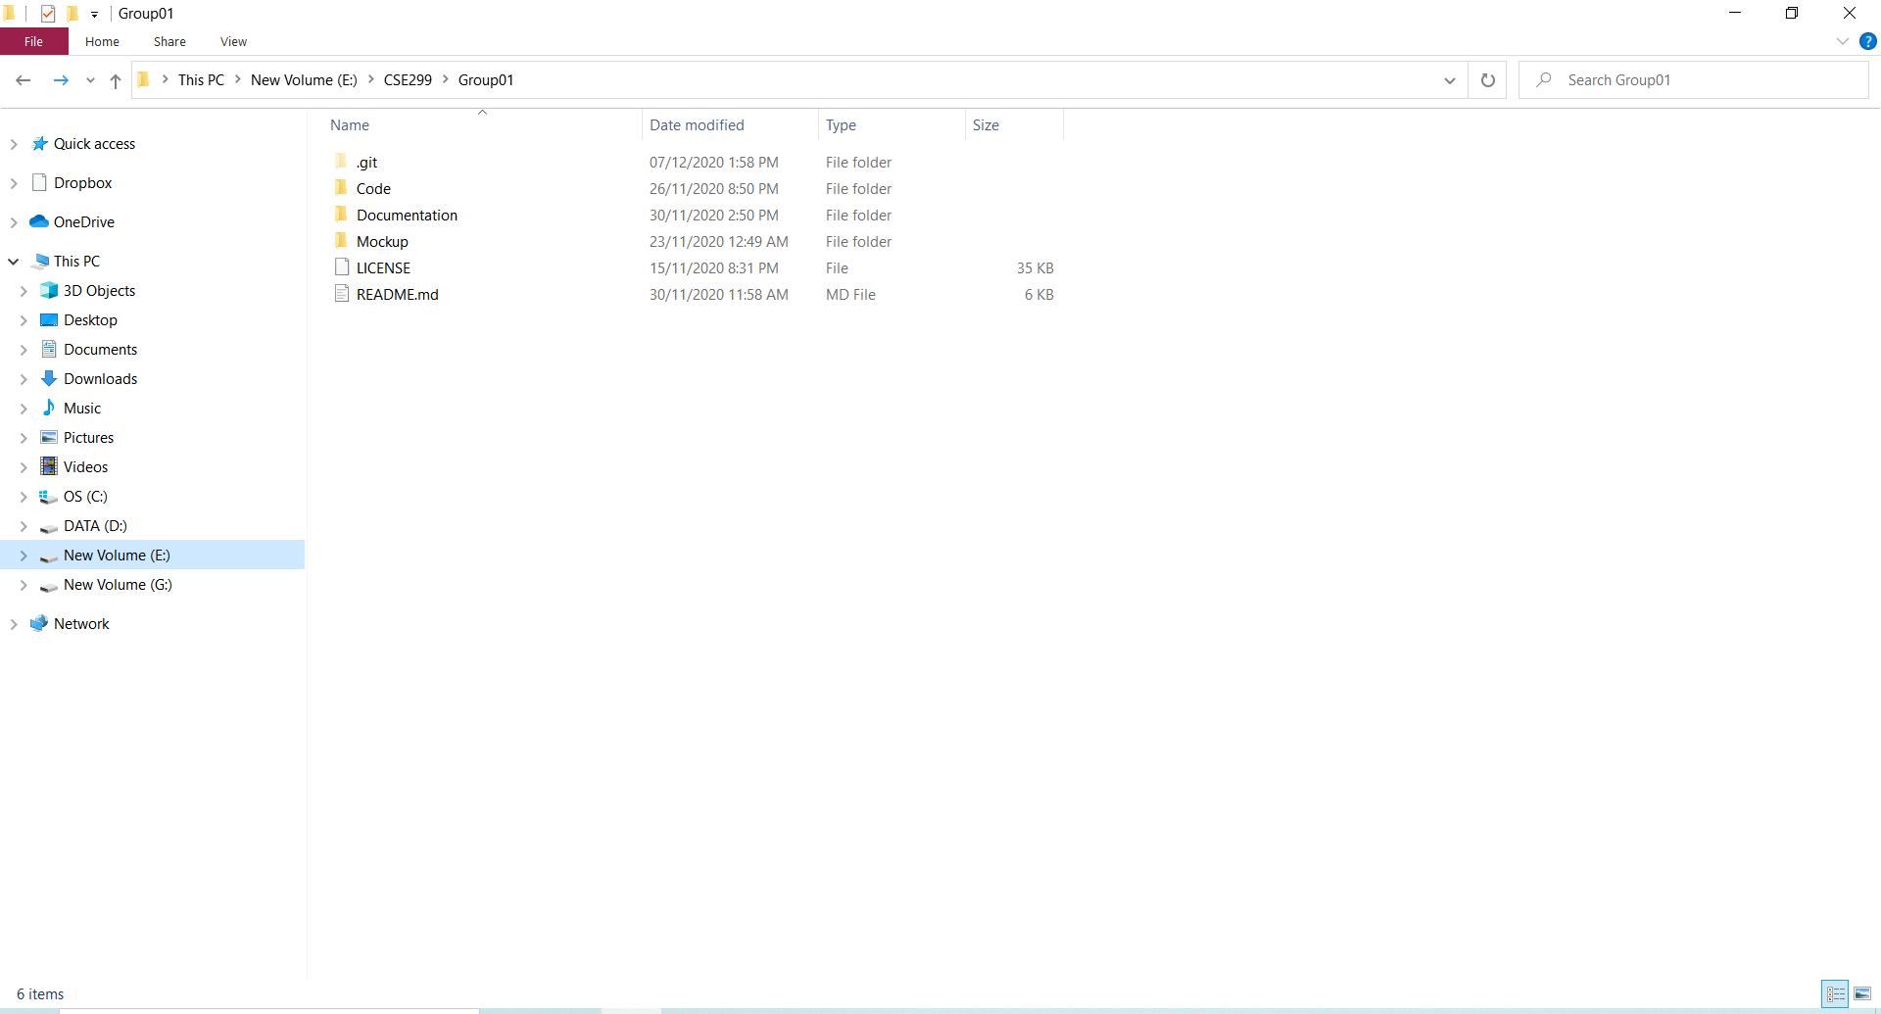
Local Repostiory

